Slide 1

BLUE TEAM
CAN ÖZTAŞ

Slide 2



Red Team
Blue Team
Simulated adversary, attempting to identify
and exploit potential weaknesses withing the organisation's cyber defenses
Identifying an attack path that breaches the organisation's security defense through real-world attack techniques
Responsible for defending an enterprise's use of digital assets and information systems against a group of attackers.
It covers detecting, prevention and response threats
Maintaining the internal network

Slide 3
What is Blue Team?
Incident Response
Digital Forensics
SOC
Cyber Threat Intelligence
Malware Analysis
Network Defense

Slide 4
Blue Team Sources
SIEM
EPP/EDR
XDR
SOAR
NDR
MDR
DLP
Endpoints

Slide 5
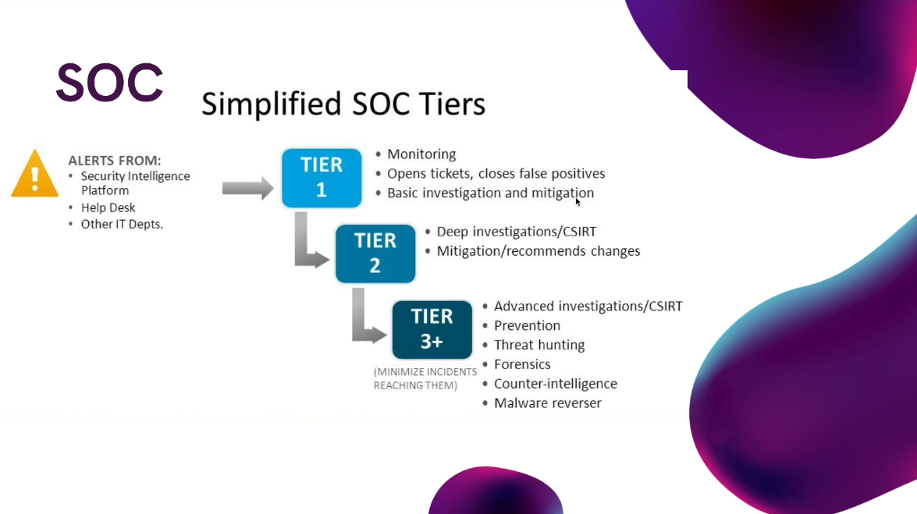

Slide 6
Incident Response
Incident response (sometimes called cybersecurity incident response) refers to an organization’s processes and technologies for detecting and responding to cyberthreats, security breaches or cyberattacks.

Slide 7

Incident Response example
On ArcSight SIEM:
Incident Time: 3.00 A.M.
Log Source: PfSense Firewall
Source IP: 103.199.217.2
Destination IP: 10.0.0.11 (Zabbix Server)
Log Detail: From 103.16.206.242 ip address to 10.0.0.11, there is an ssh allow activity on Firewall.

Slide 8
Incident Response
Layer 1 : If “the incident is false positive” :
Report as False positive
Else:
Escalate to Layer 2
Layer 2 :
Detection: IP reputation
: Firewall allow/disallow
: Successfull/unsuccessfull login on the server
Response : Isolation, Digital Forensics, Malware analysis
d)

Slide 9

Incident Response example
On SIEM or SOAR product:
Layer 1 analyst see an incident as follows:
“Successful password spray from 18.224.204.126”
The questions that should be answered:
Is the IP address on Local or Remote
If it is remote, is the ip address is harmful
Which users and computers are affected

Slide 10
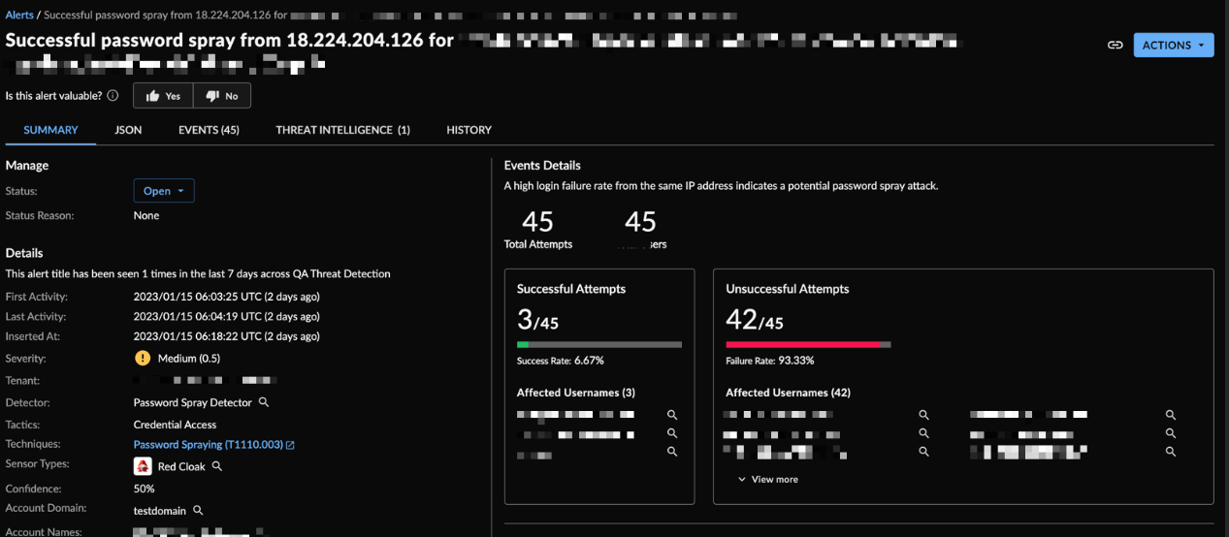

Slide 11
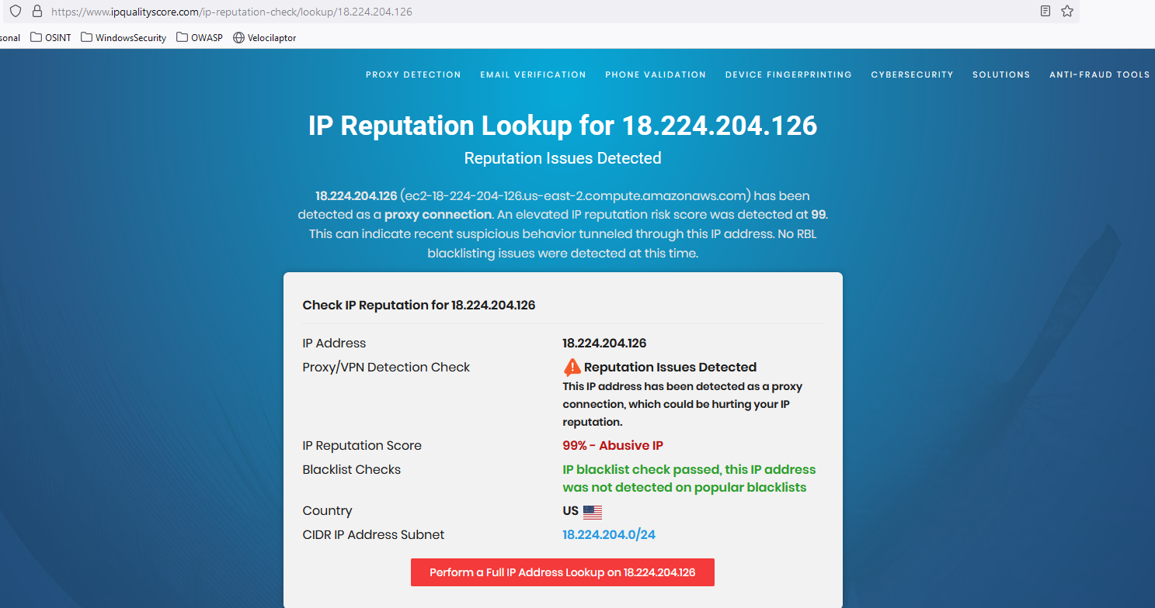

Slide 12

Incident Response: Layer 2
Check if the requests blocked or allowed on firewall
If not, block the ip
Transfer the case to Incident Response team to detect the affected users and computers. Isolate the computers from the Network.
and & or
Transfer the case to Digital Forensics, malware analysis teams if the company has the these teams.

Slide 13
Digital Forensics
Forensic is the science and technology in the investigation and collection of evidence in a court of Law.
Digital Forensics is the collection of investigation and finding evidence of an incident, data lease or cyber crime.

Slide 14

Dennis Rader, also known as BTK ( Bind, torture, kill) was a serial killer. The case took a major turn when he sent a floppy disk to a local news station that was later taken to into evidence by the police. The police were able to recover a deleted word document on the drive, and using the metadata and some other evidence, they pinpointed and arrested him.
A real world example

Slide 15

Examining Log Files
1)
2)
Event Logs
Access security Logs
3)
4)
Windows Registry
Network Logs

Slide 16
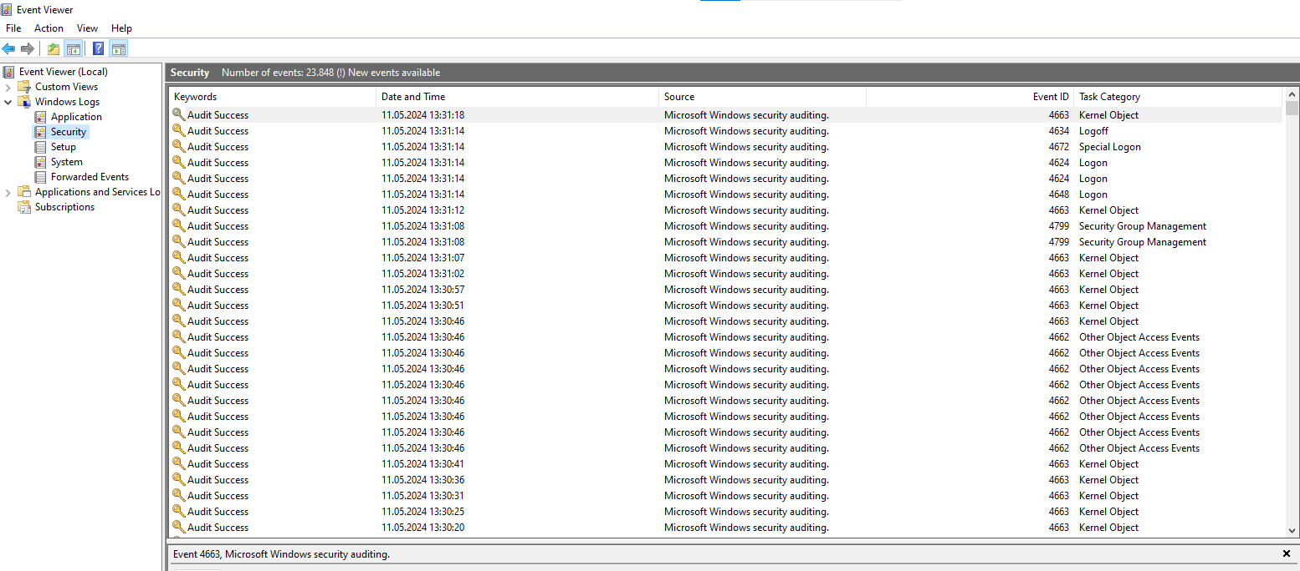
Event Logs

Slide 17
Windows Logs
We can look at the followings;
Which processes are created from external or internal,
Which files are deleted
Which files are changed etc.

Slide 18

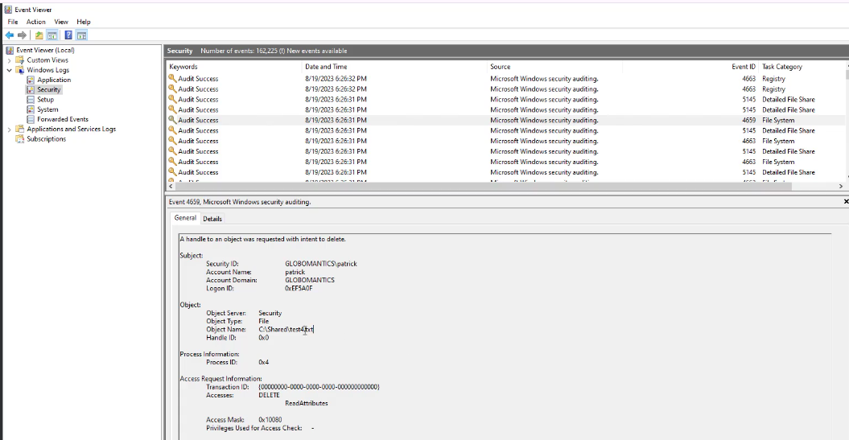

Slide 19
Windows Registry
The Windows Registry Editor (regedit) is a graphical tool in the Microsoft Windows operating system (OS) that enables authorized users to view the Windows registry and make changes. We can find most of the registry on Windows file system on the location “C:\Windows\System32\config”
The following hives are important:
DEFAULT
SAM
SECURITY
SOFTWARE
SYSTEM

Slide 20
Windows Registry
The other important hives are:
on C:\Users\<username> :
NTUSER.DAT (mounted on HKEY_CURRENT_USER when a user logs in)
on C:\Users\<username>\AppData\Local\Microsoft\Windows
USRCLASS.DAT (mounted on HKEY_CURRENT_USER\Software\CLASSES)
Amcache Files
Windows creates this hive to save information on programs that were recently run on the system.
This files are located at:
C:\Windows\AppCompat\Programs\Amcache.hve

Slide 21

Transaction Logs and Files
. The transaction logs can be considered as the journal of the changelog of the registry hive
Windows often uses transaction logs when writing data to registry hives
the transaction log for the SAM hive will be located in C:\Windows\System32\Config in the filename SAM.LOG

Slide 22
Automation of Windows Registry Forensic
Eric Zimmerman has developed a handful of tools that are very useful for performing Digital Forensics and Incident Response
One of them is the Registry Explorer
It can load multiple hives simultaneously and add data from transaction logs into the hive to make a more 'cleaner' hive with more up-to-date data.

Slide 23

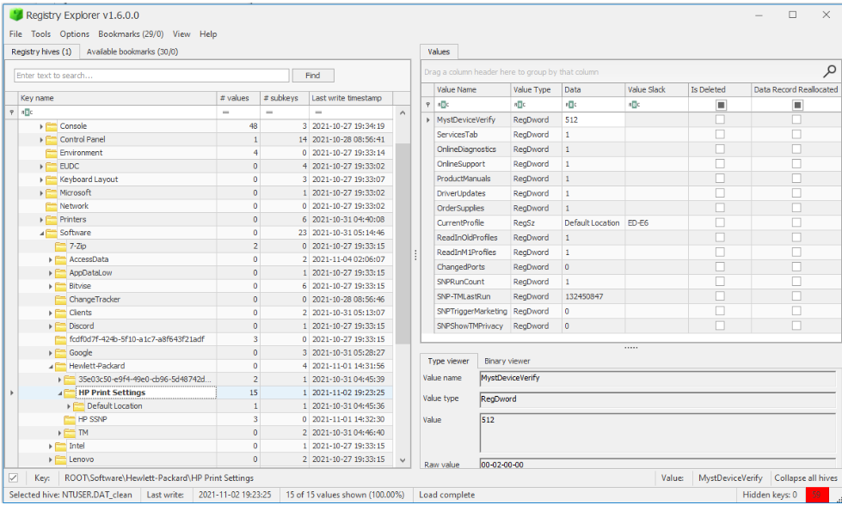

Slide 24
answer
The impression you leave online
a)
What is a digital footprint?

Slide 25

Questions & Comments

